Slide 1


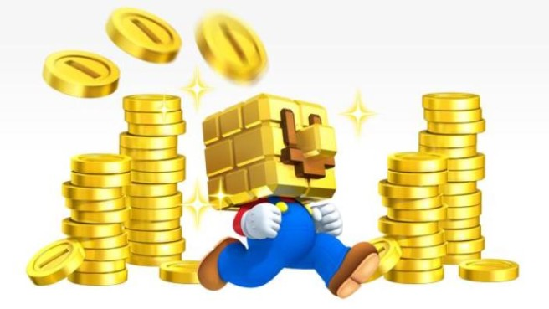

Gambling I
Produced by Dr. Mario
UNC STOR 390

Slide 2
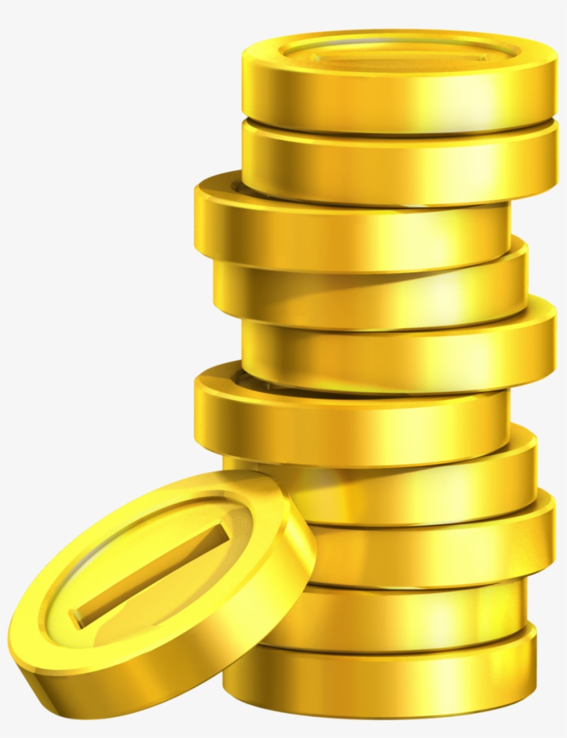
Sports gambling 101
Bookmaker
Person/Organization Who Takes Bets and Pays Off Bets in Sports
AKA a Bookie (Individual)
AKA a Sportsbook (Organization)
AKA The Real Winner
AKA Someone Who Profits Off Stupidity
Five Online Sportsbooks for US Bettors
Bovada
5Dimes
BetOnline
GTBets
Youwager

Slide 3
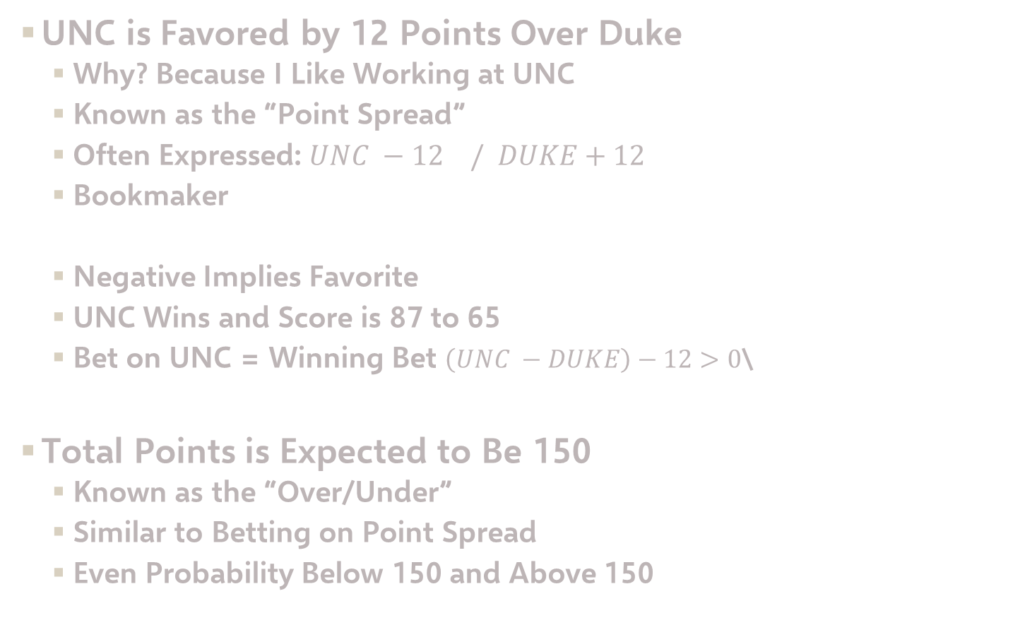
Sports gambling 101
UNC is Favored by 12 Points Over Duke
Why? Because I Like Working at UNC
Known as the “Point Spread”
Often Expressed: $UNC −12 / DUKE+12$
Bookmaker
Negative Implies Favorite
UNC Wins and Score is 87 to 65
Bet on UNC = Winning Bet $\left(UNC −DUKE\right)−12>0$\
Total Points is Expected to Be 150
Known as the “Over/Under”
Similar to Betting on Point Spread
Even Probability Below 150 and Above 150
$$P\left(UNC−DUKE>12\right)=P\left(UNC−DUKE<12\right)≈50\%$$

Slide 4
Sports gambling 101
Unit
Popular Term in Sports Betting
Measurement of the Size of Someone’s Bet
+25 Units Doesn’t Mean Anything and is Arbitrary
What is Better?
Person 1: Started with $100 and Now Has $800
Person 2: Started with $1000 and Now Has $8000
If Each Unit is $1,
Person 1 is Up 700 Units
Person 2 is Up 7000 Units
If Each Unit is 1% of Bankroll,
Person 1 is Up 700 Units
Person 2 is Up 700 Units

Slide 5
Sports gambling 101
Odds
Ratio of Probability of Winning to Probability of Losing
Fractional Representation:
10/1
1/1
1/10 or 0.1/1
American Representation:
+1000
100 or -100
-1000
Interpretation for Payout
Bet $1 to Win $10 or Bet $100 to Win $1000
Bet $1 to Win $1 or Bet $100 to Win $100
Bet $1 to Win $0.10 or Bet $1000 to Win $100

Slide 6
Sports gambling 101
Payout Odds
Bookmakers Use Odds to Payout
Suppose Team Has 50% Chance of Winning
Fair Odds is 1/1 (100 or -100)
Most Common Odds is 10/11 (-110)
Interpretation of Typical Odds
Bet $11 to Win $10 (Total=$21)
Bet $110 to Win $100
Bookmaker Makes 10% Profit on Bets
Formula: Total Amount If You Win
Formula: Total Amount If You Lose
$$Total=Base+Bet×Fractional Odds$$
$$Total=Base−Bet$$

Slide 7

Sports gambling 101
How Bettors Make Money
p = Probability Gambler Wins a Point Spread Bet
When is Expected Profit $0 If Betting $11
If Gambler Wins More Than 52.4% of Time, Gambler Wins Long Term
How Bookmakers Make Money
Vig = Bookmaker’s Mean Profit Per Dollar Bet
Suppose We Bet $11 on Bet With Odds 10/11 and Win
Suppose Bo Bets $11 on Same and Loses
Bookmaker Gets $22 and Pays $21 to Us
$$p=0.524$$
$$E\left[Profit\right]=10p−11\left(1−p\right)=0$$
$$Vig=\frac{\$1}{22}=4.5\%$$

Slide 8
Sports gambling 101
Money Line
Gamblers Don’t Only Have to Bet on Events with 50% Chance
Money Line Allows Bettor to Bet on Who Wins Outright
Money Line in 2007 NBA Finals
-450 Spurs
+325 Cavaliers
Negative Implies Favored
Interpretation
Bet $450 on Spurs and Get $100 if Spurs Win
Bet $100 on Cavaliers and Get $325 If Cavs Win
Strategy for Betting on Spurs
Want Expected Profit to Be More Than $0
p = Probability Spurs Win
Believe Spurs Have 82% Chance of Winning
$$E\left[Profit\right]=\left(100\right)×p+\left(−450\right)×\left(1−p\right)>0$$

Slide 9
Sports gambling 101
Money Line
Strategy for Betting on Spurs
Want Expected Profit to Be More Than $0
p = Probability Spurs Win
Believe Spurs Have 82% Chance of Winning or Higher
Strategy for Betting on Cavs
Want Expected Profit to Be More Than $0
Believe Spurs Have 76% Chance of Winning or Lower
$$E\left[Profit\right]=\left(100\right)×p+\left(−450\right)×\left(1−p\right)>0$$
$$E\left[Profit\right]=\left(−100\right)×p+(325)×\left(1−p\right)>0$$

Slide 10

Sports gambling 101
Arbitrage Betting Opportunity
Combination of Bets Without Risk
Consider the Following Betting Lines
Bookie 1 Offers Better Odds on Colts = Take Colts
Bookie 2 Offers Better Odds on Bears = Take Bears

Slide 11
Sports gambling 101
Arbitrage Betting Opportunity
Suppose You Bet x Dollars with Bookie 1
Suppose You Bet $100 Dollars with Bookie 2
Profit if Colts Win
Profit if Bears Win
Betting Between $122 and $125 With Bookie 1 Guarantees Win
$$\left(\frac{100}{122}\right)x−100>0 if x>\$122$$
$$125−x>0 if x<\$125$$

Slide 12
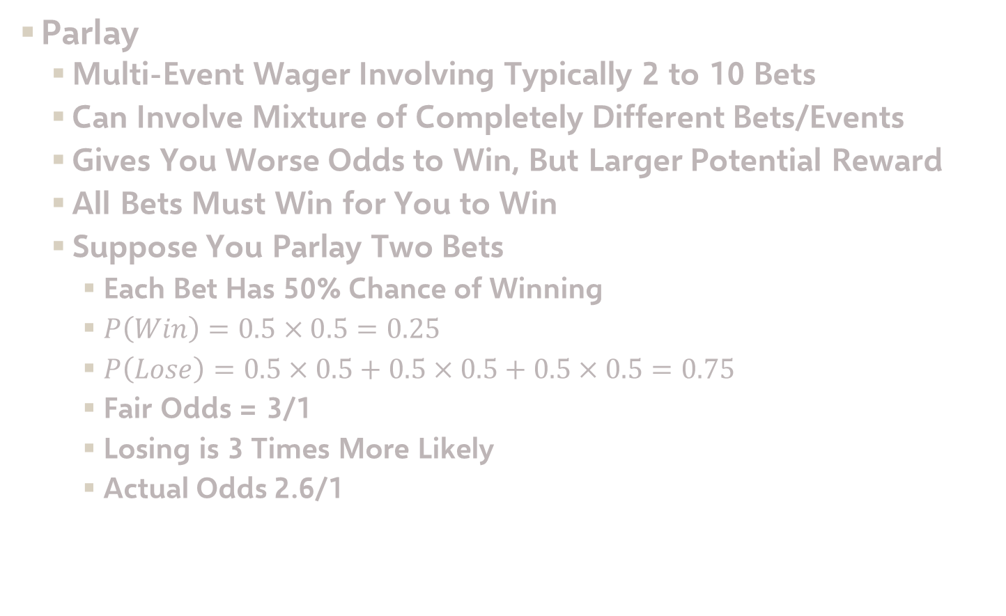
Sports gambling 101
Parlay
Multi-Event Wager Involving Typically 2 to 10 Bets
Can Involve Mixture of Completely Different Bets/Events
Gives You Worse Odds to Win, But Larger Potential Reward
All Bets Must Win for You to Win
Suppose You Parlay Two Bets
Each Bet Has 50% Chance of Winning
$P\left(Win\right)=0.5×0.5=0.25$
$P\left(Lose\right)=0.5×0.5+0.5×0.5+0.5×0.5=0.75$
Fair Odds = 3/1
Losing is 3 Times More Likely
Actual Odds 2.6/1

Slide 13
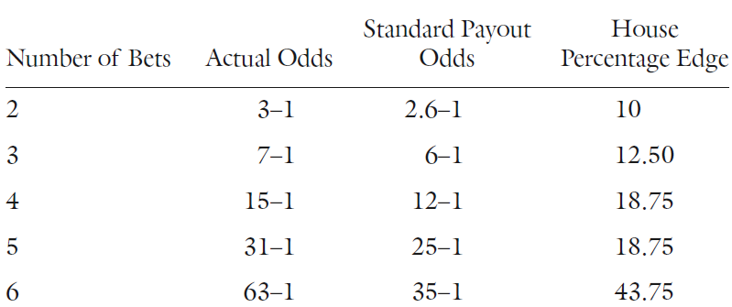
Sports gambling 101
Parlay
House Edge for Parlay if Betting $100
For Fair Odds, Expected Profit is $0
For 2.6/1 Odds, Expected Profit is …
House Expected to Win $10
Percent of Bet = +10%
Table of Payoffs
$$E\left[Profit\right]=0.25×260+0.75×100=−10$$

Slide 14
Sports gambling 101
Parlay
Correlated Events in Parlays
Bet 1: Tom Brady Throws Touchdown to Gronkowski
Bet 2: Tom Brady Throw 3 Touchdowns
Notice the Following Conditional Probability
Fair Odds If Events are Independent: 3/1
Probability of Winning Parlay
Fair Odds for This Parlay: 1.22/1
Suppose You Bet $100 and Win
You Should Win $122
You Will Win $300
$$P\left(Win Bet 1\right)=0.5=50\%$$
$$P\left(Win Bet 2\right)=0.5=50\%$$
$$P\left(Win Bet 1 | Win Bet 2\right)=90\%$$
$$P\left(Win Parlay\right)=P\left(Win Bet 2\right)×P(Win Bet 1|Win Bet 2)=45\%$$

Slide 15
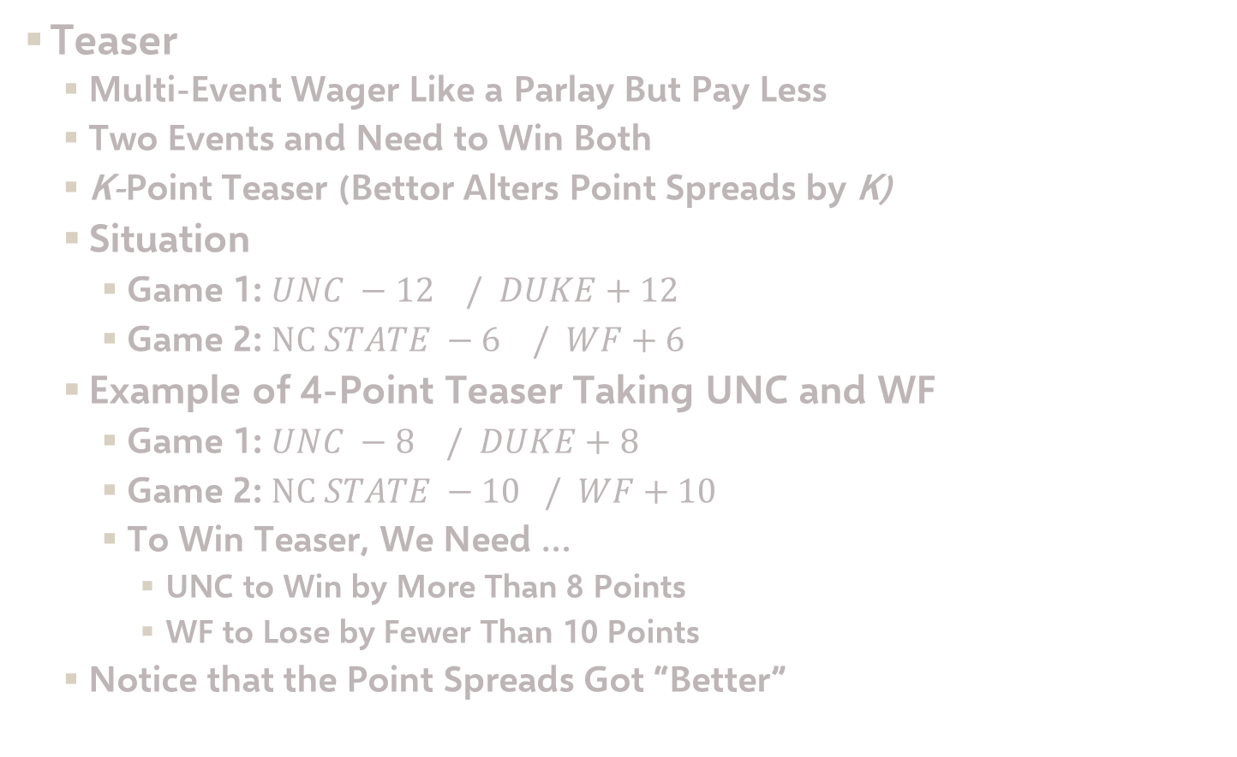
Sports gambling 101
Teaser
Multi-Event Wager Like a Parlay But Pay Less
Two Events and Need to Win Both
K-Point Teaser (Bettor Alters Point Spreads by K)
Situation
Game 1: $UNC −12 / DUKE+12$
Game 2: $NC STATE −6 / WF+6$
Example of 4-Point Teaser Taking UNC and WF
Game 1: $UNC −8 / DUKE+8$
Game 2: $NC STATE −10 / WF+10$
To Win Teaser, We Need …
UNC to Win by More Than 8 Points
WF to Lose by Fewer Than 10 Points
Notice that the Point Spreads Got “Better”

Slide 16
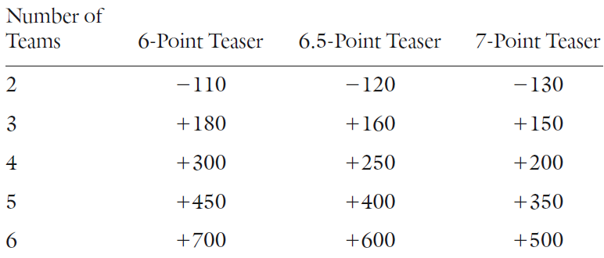
Sports gambling 101
Teaser
Either Game “Pushes” = Teaser “Pushes
In Football, Teasers Usually Involve 6, 6.5, or 7 Points
Typical Teaser Payoff Grid
History of 7-Point Teasers
Win 70.6% of the Time
Push 1.5% of the Time
Lose 27.9% of the Time
Bet $130 to Win $100
Bet $100 to Win $500

Slide 17
Sports gambling 101
Teaser
Probability of Winning Teaser
Probability of Pushing Teaser
Probability of Losing Teaser
Expected Profit of 7-Point Teaser Bet of $130
$$P\left(Win\right)=0.706×0.706=0.4984$$
$$P\left(Push\right)=0.015×0.015+0.015×0.985+0.985×.015=0.0298$$
$$P(Lose)=0.279×0.279+0.279×0.721+0.721×.279=0.4802$$
$$E\left[Profit\right]=0.4984×100+0.0298×0+0.4802×\left(−130\right)=−\$12.58$$

Slide 18
Freakonomics for bookies
Steven Levitt
Famous for Freakonomics
Showed Bookmakers Can Get a Profit Exceeding 4.5% Per Dollar Bet
People Believe Bookmakers Try to Set “Prices” So Half on Both Sides
NFL Data Shows Contradiction to This Notion
½ of Games Have Uneven Split of Bets
Specifically Seen in Games Where Home Team is Underdog
Most Wagers on Visiting Team In These Cases
Bookmakers Set Unfair Spreads to Exploit Systematic Biases
Bias Toward Favorites
Bias Toward Visiting Teams
Bookmakers are Gambling With Gamblers

Slide 19
Freakonomics for bookies
Implications on Gamblers
Percent of Bets That Win
Conclusion: Favorites Are Not Good Bets (<50%)
Example
UNC is 12 Points Better Than Duke
You Know Most People Will Bet on UNC
Bookmaker Line: UNC -12/ Duke +12
Trap People Who Have Definite Biases
 | Underdog | Favorite
Home | 57.7% | 49.1%
Away | 50.4% | 47.8%

Slide 20
Freakonomics for bookies
Expected Earnings
Probability Bookie Wins = 50.55%
Probability Bookie Loses = 49.45%
Expected Earnings Per $10 Bet (10/11 Odds
If Bets Were Evenly Split on Both Sides
Bettor Should Bet on All Home Underdogs
Results Independent of Size of Spread
Results Consistent Over Time
$$E\left[Earnings\right]=\left(−10\right)×0.4945+\left(11\right)×0.5055=0.6156$$
$$E\left[Earnings\right]=\left(−10\right)×0.5+\left(11\right)×0.50=0.50$$

Slide 21
Freakonomics for bookies
Work by Flepp, Nuesch, and Franck
Analyzed This For Over/Under Bet in Soccer Matches
Focused on Over/Under of 2.5 Goals
Most Fans Are Biased to Bet on Over
80% of Money Waged on the Over Bet
Average Number of Goals Between 2.4 and 2.6
Discovered that Bettors Don’t Attempt to Modify the Over/Under Bet to Take Advantage of Bettors
Why Do You Think This is the Case?

Slide 22
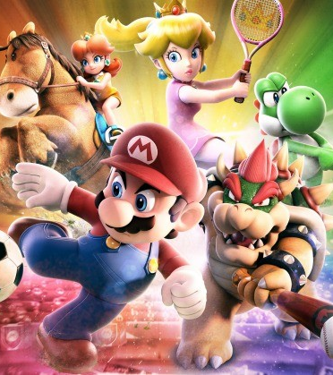
Final Inspiration
The only cure for a gambling addiction is losing all your money.
-Mahatma Mario

